Slide 1
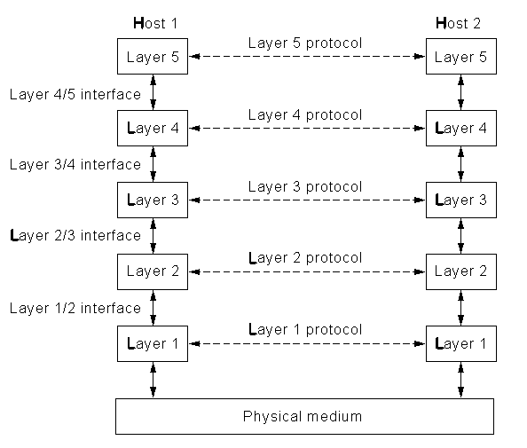
Protocol Stacks
Protocol stacks
  OSI
  TCP/IP
Notes:
In this lecture we will look at the issue of abstraction. Why is it necessary? Is it unique? What do the layers do? How do their interfaces work?

Slide 2
OSI Reference Model
Application
Application
Presentation
Presentation
Session
Session
Transport
Transport
Communication Subnet
Network
Network
Network
Network
Data Link
Data Link
Data Link
Data Link
Physical
Physical
Physical
Physical
Router
Router
Host A
Host B
Notes:
This model was produced by the International Standards Organisation (ISO) and its full name is the ISO Open Systems Interconnection (OSI) Reference Model. Its purpose is to define a general model of the processes by which separate and different communication systems can talk to each other. An open system being one that is available for communication with another open system.
The main concept that is used is that of abstraction. The idea being that abstraction enables the whole network problem to be broken up into separate self contained pieces (the layers) that interact with each other in a well defined way (the interfaces). An engineer designing software or hardware for their piece of the abstraction need know nothing about the properties or problems of the other pieces.
The definition of the layers is NOT unique as this is a model of convenience rather than of fundamental classification. Indeed, as we will see, TCP/IP does not fit into this classification. However, this model is widely known and is sufficiently general to cover just about any situation.
Clearly, there are trade offs in producing such a model. If the number of layers is too large we would be unlikely to maintain the independence of each layer. It is also likely that the size of the interfaces would grow to accommodate what would be communication between non-adjacent layers. If there are too few layers then we have not achieved any real degree of abstraction and the original problem of having to know too much remains.
Finally, remember this is a model not a set of protocols. It tells you what sort of thing you should do not how you should do it.

Slide 3
Interfaces
Specifies the relationship between layers
  What services are offered
  What formats are required
Should be fixed
  Layers can be altered without disturbing other layers
  Protection from technology change
Notes:
The interfaces are probably the most important entity to get right in designing a protocol stack. They specify the way layers should communicate and interact with each other. Each layer defines through its interface to the next layer up exactly what it will do and at what ‘cost’. The interface also specifies how the information will be transferred between the layers.
The reason the interface specification is so important is that if it can remain fixed over the lifetime of the protocol stack then changes can be made in any given layer in isolation from any consideration of what is happening in any other layer. If the interface is badly designed or is insufficiently flexible then a change in one layer could also need a change in the interface and hence reconstruction of the next layer or even the whole stack.

Slide 4
Physical Layer
This is where the actual transmission takes place.
The physical layer takes a stream of bits and sends it onto the network. It knows nothing about where the data is going to, what it consists of or how it came to be constructed.
It does know how to recognise bits on the network through the voltage on the line or the optical power received.
Network Card on Host A
Network Card on Router
Network Card on Router
Network Card on Host B
Notes:
The physical layer refers to the actual transmission of individual bits of information. They could be carried as voltages on coaxial cables, pulses of light on optical fibre or microwave signals via satellite. As far as the data link layer is concerned, it sees a virtual physical layer which carries bits of information (rather than physical quantities).
The format of the information is decided here: Return-to-zero (RZ), no-return-to-zero (NRZ), phase shift keying (PSK) frequency shift keying (FSK).
Each piece of the network is a separate entity. In the diagram on the slide, the information bit could be represented in three different formats on the three links.

Slide 5
Data Link Layer
Deals with frames of information
  constructing them
  recognising them from the stream of bits handed up by the physical layer
Handles bit errors that occur in the physical layer
Copes with lost and duplicate frames
Deals with flow control
Special sublayer (MAC) for broadcast networks
Data Link on Host
Data Link on Router
Data Link on Router
Data Link on Host
Notes:
The data link layer takes information from the network layer and breaks it up into frames of bits which enable it to cope with potential problems at the physical layer. Most transmission media suffer from random errors (in fact Shannon tells us we should have errors for high efficiency) and the purpose of this layer is to eliminate them. As far as the network layer is concerned it is handing packets to and getting packets from a perfect error free virtual physical layer.
Bits are added to the data from the network layer to allow errors to be detected and in some cases corrected.
The layer may also use special bit patterns to allow it to detect the start and end of frames. In order to do this the patterns must be unique. If they should occur at some point in the data then something has to be done to hide them.
Each individual data link is still independent. The protocols that are used in each link can be different (simplex, duplex, sliding window.....).
The layer also deals with the issue of flow control (actually this applies to most layers) so that if too many frames arrive for it to cope with the flow is reduced.
On broadcast networks, such as Ethernet, there is a special sublayer called Medium Accsess Control (MAC) which deals with the problems of conflict between to simultaneous access attempts.

Slide 6
Network Layer
Routing
  how will the information get to its destination?
Addressing
  addresses may change in different parts of the network
Billing
  mostly an issue in telephone networks
  bit transport charging could happen
Network on Host
Network on Router
Network on Router
Network on Host
Notes:
The network layer is the highest layer that will exist in a router. It is also the last layer which works on a link by link basis. As far as the transport layer is concerned it is handing information to a perfect virtual point-to-point physical layer albeit on a packet by packet basis.
The network layer is primarily responsible for the routing of the information across the whole network. It can determine if the destination is on its subnet, in which case the packet is simply sent through the appropriate routers, or if the destination is ‘somewhere else’, in which case the packet is sent via the gateway to the outside world. When the destination network is different it must also deal with any problems that might arise from their differences.
It is this layer which defines the network addresses that the transport layer must use.
Exactly how much functionality is built into this layer depends on the type of service which is being offered. This is the prime battle ground of the connection-oriented vs connectionless debate. TCP/IP and ATM take different stances at this point as one is principally connectionless and the other is connection-oriented.

Slide 7
Transport Layer
End to end control
  splitting data into chunks
  ensuring delivery
  recombining chunks
Connections
  manages network connections
  controls throughput
Transport on Host
Transport on Host
Notes:
The transport layer protocols on the source and destination machines communicate (virtually) directly with each other. They do this through the message headers which they attach to data coming from the session layer and through control messages which may be generated in the network.
The transport layer can optimise the traffic from the session layer (note not from a particular source program) across the network. This may involve creating multiple network connections or multiplexing data from separate streams onto a single channel. This must all be done transparently so that each source of a stream sees the transport layer as a perfect virtual permanent connection. In this context the degree of permanency depends on the service being offered to the session layer. In order to maintain transparency to the session layer the transport layer must keep track of how the data is split or multiplexed and must communicate that information to its counterpart.
It is here that the difference between connection oriented and connectionless service will appear to the session layer. In practice the amount of work that needs to be put in to packet reordering and retransmission depends on the network service being used. This is one of the differences between ATM and TCP/IP

Slide 8
Session Layer
Session examples
  remote login, the session is maintained even if no data is being transferred
  synchronisation, progress of operations is tracked so that crashes can be recovered from
  token management
Session on Host
Session on Host
Notes:
A session is a connection with state information that can be maintained between two machines. The state information might describe the progress through some session protocol, information about the form of encryption being used or the possession of tokens used to regulate the progress of a protocol.
The regulation of progress is known as dialogue control. The simplest example being the use of the word ‘over’ during radio communications. ‘Over’ can be thought of as a token which the users exchange to keep track of whose turn it is to speak.
The session layer may not be involved in a particular communication between applications.

Slide 9
Presentation Layer
Manages representations
  ASCII vs Unicode
  Integer types
  Floating point numbers
Presentation on Host
Presentation on Host
Notes:
The presentation layer is responsible for translating between different formats that might be used on different machines. This requires the layer to have knowledge of specific data formats such as characters, integers and floating point numbers. Data is not transmitted as an arbitrary sequence of bits as in most layers but is treated in a specific context. The idea here is that the presentation layer makes the remote machine look as if it is of the same type of architecture and uses the same format for representing data.
One common area is the representation of characters transmitted as Email. The presentation layer needs to be able to translate between the various formats (ASCII, Unicode) that exist for the binary encoding of character information.

Slide 10
Application Layer
Highest level protocols
  E mail
  Directory look up
  Virtual terminals
  File formats
  WWW
Application on Host
Application on Host
Notes:
The highest level protocols exist here. Working in this layer, the programmer is almost completely unaware of the presence of the network. For example, when using the WWW, clicking on a hyperlink the programmer knows to hand that URL to the application layer which will hand back the contents of the URL. At this level, all the users appear to be connect to the same machine with the same file store. The ultimate level of abstraction has now been achieved.

Slide 11
OSI and TCP/IP
Application
Application
Presentation
Session
Transport
Transport
Network
Internet
Data Link
Host to Network
Physical
Notes:
The comparison between the OSI reference model and the TCP/IP protocol illustrates the point about the classification of the protocol stack not being unique. In fact TCP/IP does not uniformly map onto the OSI reference model and this was one of the reasons for OSI not being more widely used. For a good discussion of the interplay between politics and technology see sections 1.4.3 to 1.4.5 of Tanenbaum.

Slide 12
Next Lecture
Switching architectures
Blocking
Buffering
Notes:
In the next lecture we will look at some of the architectures that are used to achieve switching in networks. We will look at the problem of blocking that happens when one network connection makes other connections impossible and the related issue of buffering that arises when there is contention for a resource.

